Slide 1
Data Analyst Portfolio Project
Customer Segmentation & Clustering -
S.K.KOKATE

Slide 2
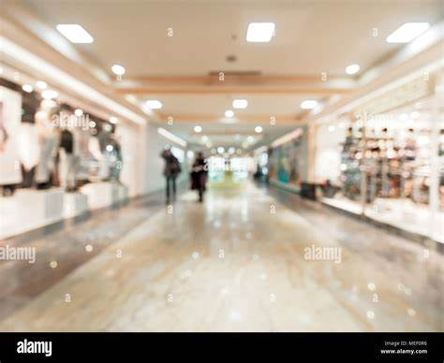
Segment Shopping Customers
Problem Statement: understand the Target Customers for the marketing team to plan a strategy
Context: Your boss wants you to identify the most important shopping groups based on income, age and the mall shopping score.
He wants the ideal number of groups with a label for each.

Slide 3
Objective Market Segmentation
Divide your mall target market into approachable group. Create subsets of a market based on demographics behavioral criteria to better understand the target for marketing activities.

Slide 4
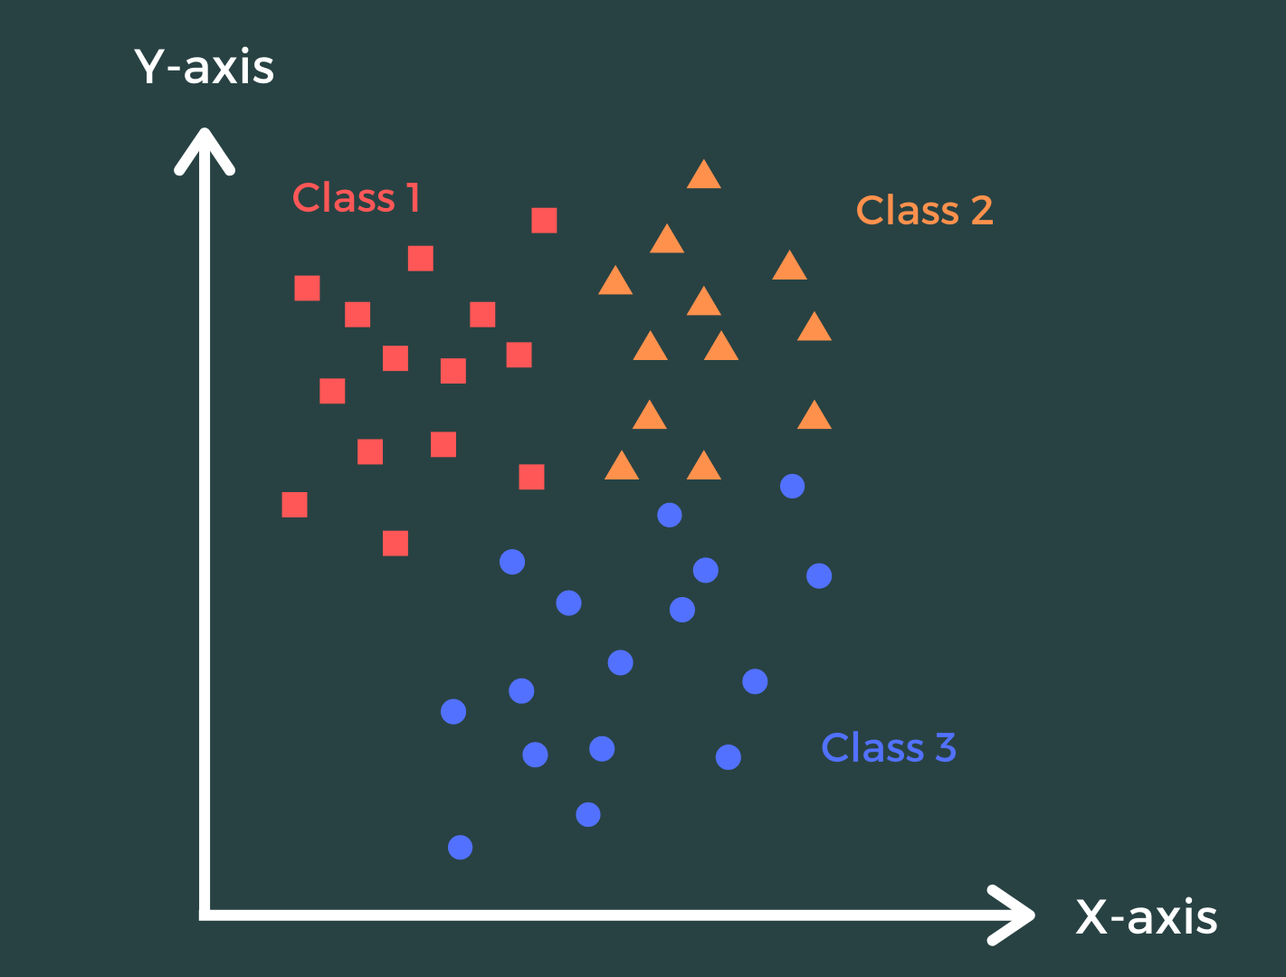
The Approach
Perform some quick EDA(Exploratory Data Analysis)
Use KMEANs Clustering Algorithm to create our segments.
Use Summary Statistics on the clusters.
Visualize

Slide 5
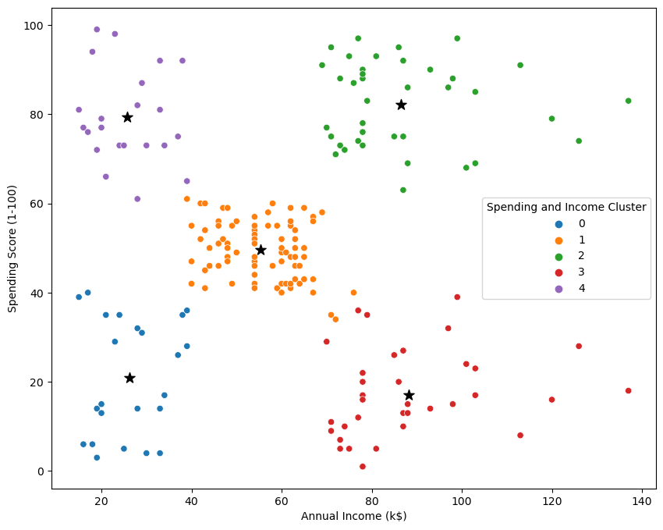
Analysis
Target Cluster
Target group will be cluster 1 which has a high Spending Score and high income
60 percent of cluster 1 shoppers are women. We should look for ways to attract these customers using a marketing campaign targeting popular items in this cluster
Cluster 2 presents an interesting opportunity to market to the customers for sales event on popular items.

